Slide 1
Emotion Detection Using Convolutional Neural Networks (CNNs)
Jamal Tikouk
younes saouabeddine

Slide 2
Table of Content
Introduction
Convolutional Neural Networks (CNNs)
Training a CNN for Emotion Detection
Our CNN Model
Model Evaluation
Practical Application

Slide 3
Introduction
Emotion detection refers to the process of identifying and categorizing human emotions from facial expressions. It aims to provide information about individuals' emotional states and enable systems to respond accordingly. With the advancement of artificial intelligence and deep learning, facial emotion detection has gained popularity due to its potential applications in various fields.

Slide 4
Convolutional Neural Networks (CNNs)
A Convolutional Neural Network (CNN) is a specialized type of neural network primarily used in computer vision tasks.
It has proven to be highly effective in analyzing and extracting patterns from visual data.
CNNs are well-suited for tasks such as object recognition and image classification.

Slide 5
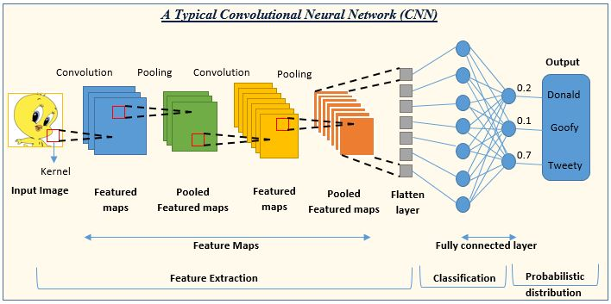
Architecture of CNNs
Convolutional layers: Apply filters to extract local features from images (edges, textures, patterns).
Pooling layers: Reduce dimensionality while retaining essential informations, making the model more robust.
Fully connected layers: Interpret the extracted features to produce the final emotion classification.

Slide 6
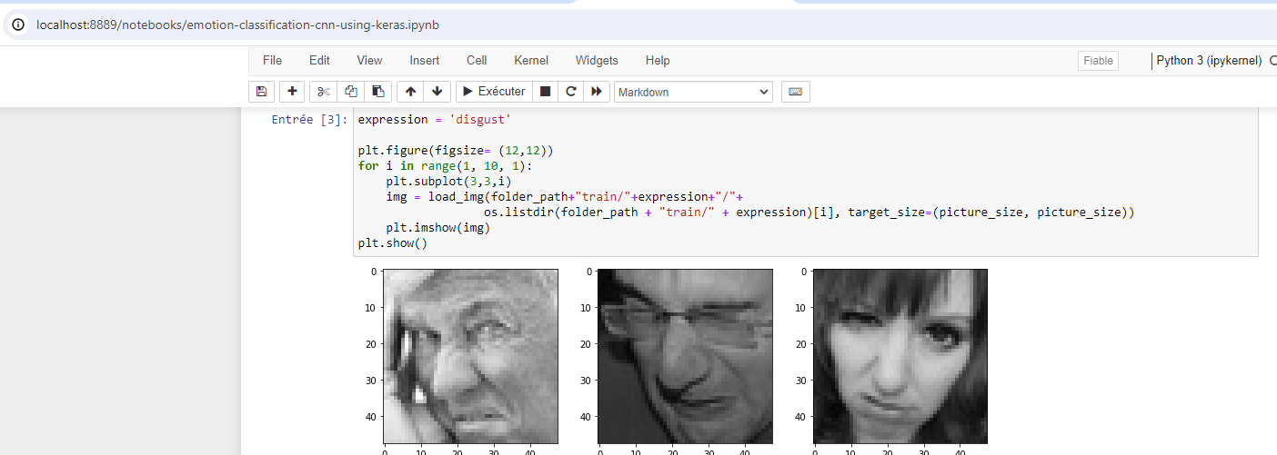

Training a CNN for Emotion Detection
Dataset:
This dataset is designed to train and evaluate our emotion recognition model from facial expressions. It is ideal for our emotion detection project due to its preprocessing and diversity.
Key Details and Features:
Size: 126 MB
Diverse expressions
Preprocessed
Categorical labels

Slide 7
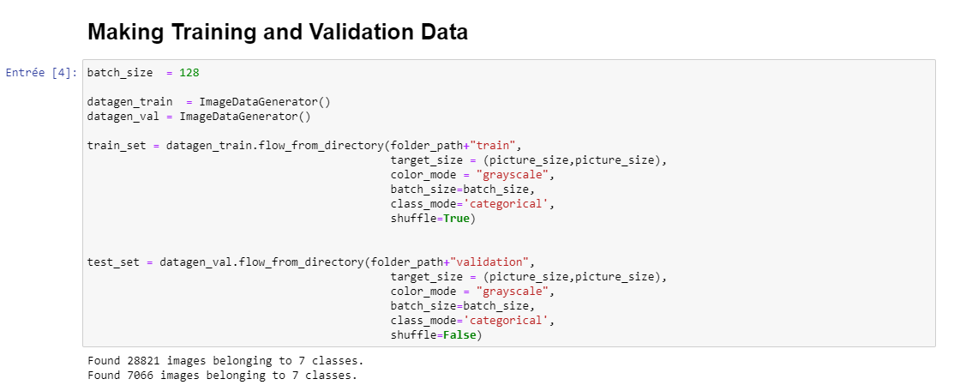
Training a CNN for Emotion Detection
This configuration allows for efficient preparation of image data for training and validation.
Data generators facilitate real-time image augmentation and processing, which is crucial for deep learning models.
Using grayscale images reduces model complexity by removing color information.
To train the model it takes us 4 hours my laptop is i5 11 éme generation 16 Ram

Slide 8
Our CNN Model
Architecture:
Our (CNN) contain four layers. Each layer performs a convolution to extract features, normalizes outputs, applies ReLU activation for non-linearity, reduces dimensions via pooling, and uses dropout to prevent overfitting. The model progressively captures complex patterns in image

Slide 9
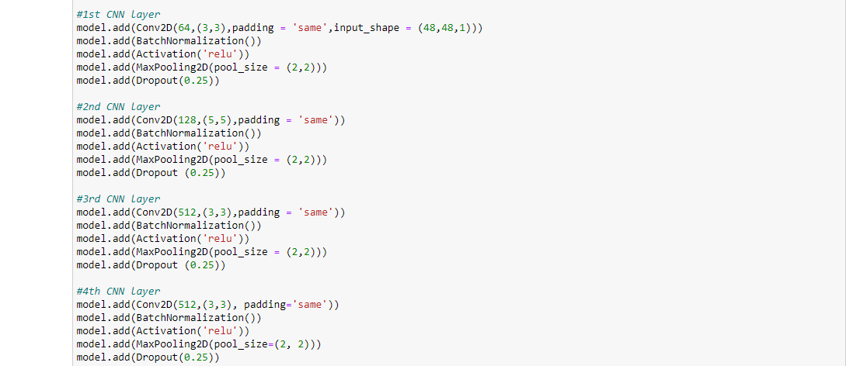
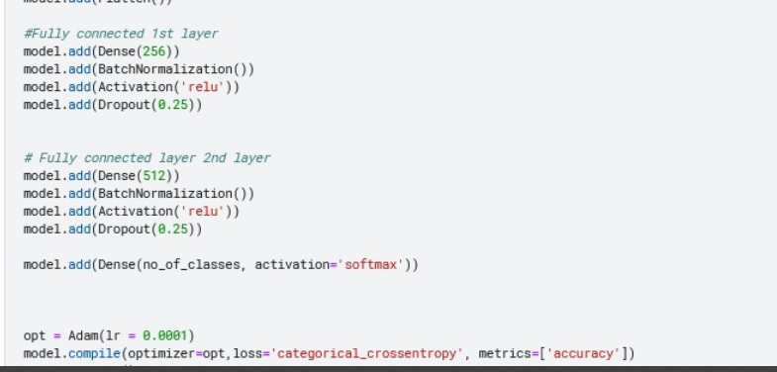
Modèle CNN :
Architecture:

Slide 10
Modèle CNN :
Architecture:

Slide 11
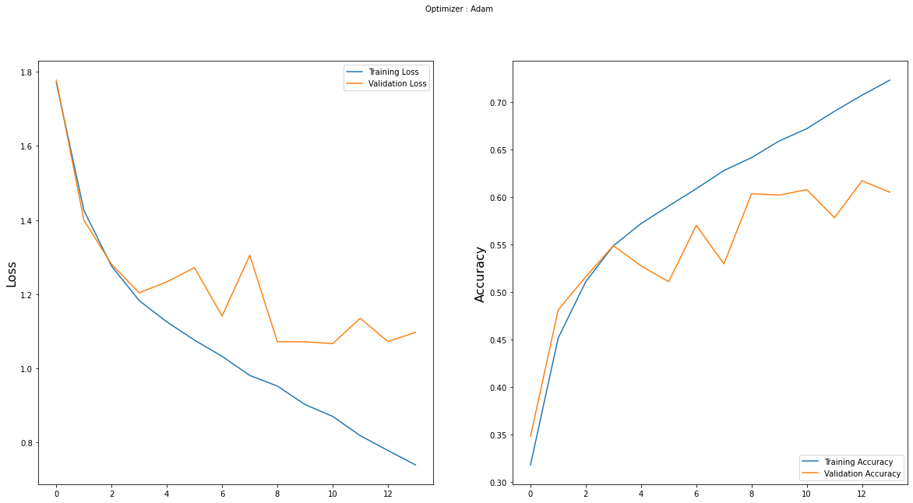
Model Evaluation
The training loss steadily decreases, while the validation loss fluctuates, indicating overall improvement with some variations.
The training and validation accuracy increase, demonstrating that the model is learning and generalizing to new data.

Slide 12
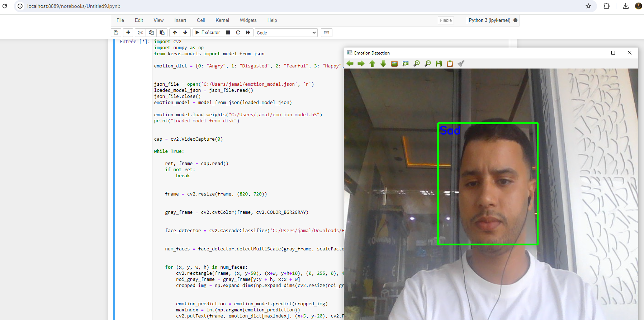

Application Pratique :

Slide 13

:

